Slide 1
Digital Portfolio
STUDENT NAME: JOTHIKA.C
REGISTER NO AND NMID: 2422K0929,28553E9E134CAAD8
2F341E3BFEBB6E96
DEPARTMENT: BSC COMPUTER SCIENCE
COLLEGE: COLLEGE/ UNIVERSITY
TIRUPPUR KUMARAN COLLEGE FOR WOMEN
BHARATHIYAR UNIVERSITY

Slide 2
PROJECT TITLE
WEB DEVELOPER

Slide 3


AGENDA
Problem Statement
Project Overview
End Users
Tools and Technologies
Portfolio design and Layout
Features and Functionality
Results and Screenshots
Conclusion
Github Link
3/21/2024 Annual Review

Slide 4

PROBLEM STATEMENT
A problem statement is a clear and concise description of an issue that identifies the gap between the current situation and the desired outcome.

Slide 5

PROJECT OVERVIEW
A project overview is a brief summary that outlines the project’s purpose, objectives, scope, and key details to give a quick understanding of what the project is about.

Slide 6

WHO ARE THE END USERS?
End users are the people who ultimately use or interact with a product, system, or service.

Slide 7

TOOLS AND TECHNIQUES
Tools and techniques are the methods, software, or instruments used to carry out tasks, solve problems, or achieve project objectives effectively.

Slide 8
POTFOLIO DESIGN AND LAYOUT
Portfolio design and layout refer to the structured arrangement and visual presentation of work samples, ensuring they are organized, appealing, and easy to navigate.
8

Slide 9
FEATURES AND FUNCTIONALITY
Features are the characteristics or attributes of a product or system, while functionality refers to how those features work to perform specific tasks or meet user needs.

Slide 10
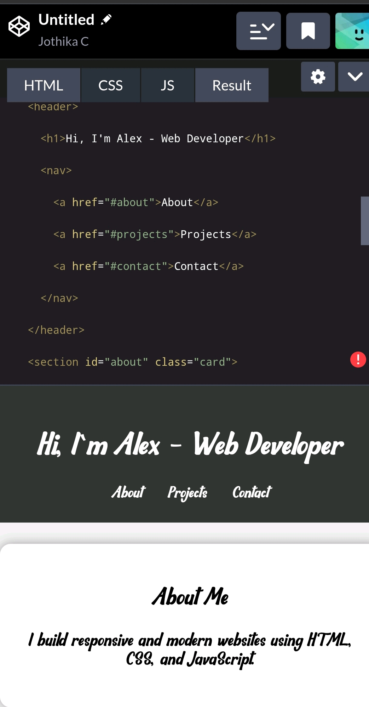

RESULTS AND SCREENSHOTS
3/21/2024 Annual Review
10

Slide 11
CONCLUSION
A conclusion is the closing section that summarizes the main points, highlights key findings, and provides final insights or recommendations.
11

